Slide 1
Cyber Club Activities on Socio-Ethical Aspects of Cyber Safety

Slide 2
“”Anyone can be a digital citizen but it’s OUR choice to be a responsible digital citizen”
Understand and practice rights and responsibilities by following ethics

Slide 3

Ethics In Real-Life
Fairness
Honesty
Responsibility
Transparency
Respect
Morality
This Photo by Unknown Author is licensed under CC BY-SA-NC

Slide 4
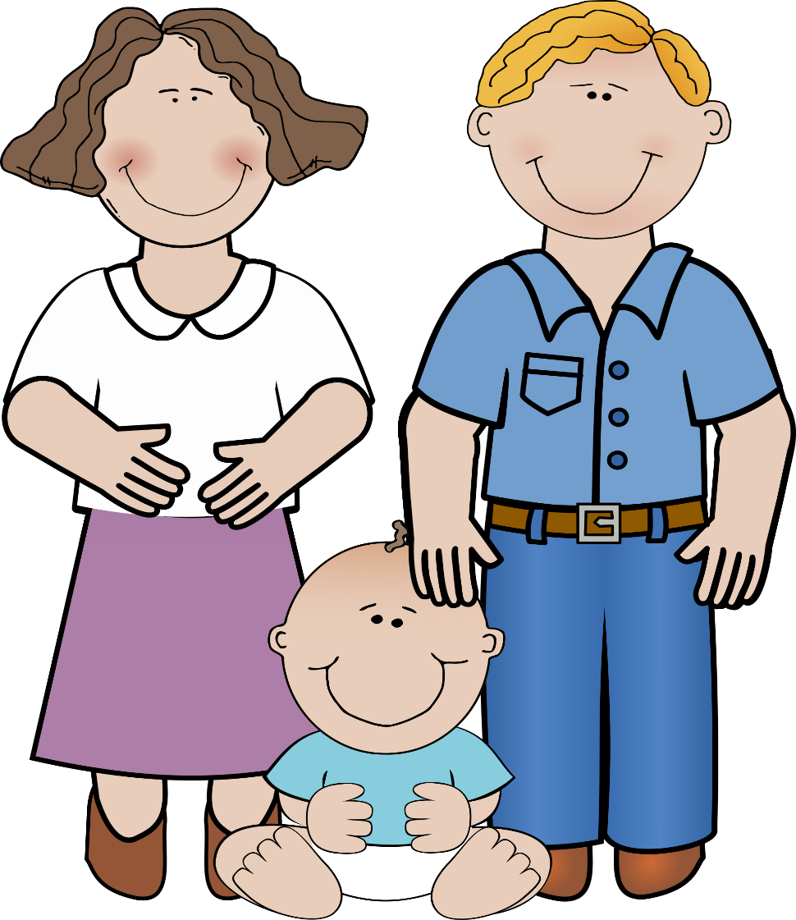
Parents teach their children to be ethical in real life.
Do not talk to strangers
Dangers of interacting with online strangers ?
Do not steal
Be honest
Importance of online etiquette?
Be polite when interacting with others
It has become more crucial than ever to teach our children cyber ethics in the same manner as we teach them real-world ethics.

Slide 5






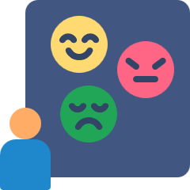

Meeta was cyber bullied by her class mates on Instagram group where four girls shared some personal images of Meeta and made fun about her vitals in a harsh manner. Soon after that a class mate posted a story of Meeta's picture on IG with insensitive comments which eventually led to Meeta slitting her wrist and undergoing severe depression thereafter.

Slide 6
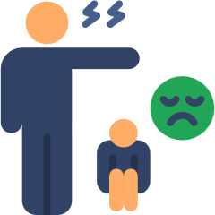
Rohan, a class Xth boy, secretly takes a photo from his cell phone of Rajat, an over-weight boy, who is undressing in the gym locker. Within minutes, the photo is sent to their class group. When Rajat finds out, he is so embarrassed that he refuses to return to school.

Slide 7

In another case, a police officer told reporters, "A man used to create fake profiles to send friend requests to people. After winning their trust he used to ask them for money to be transferred to fake e-wallet accounts citing some emergency. After receiving the money, he used to close down such accounts.”
This Photo by Unknown Author is licensed under CC BY-NC

Slide 8
Cyber Ethics
A set of guidelines for appropriate and responsible online behaviour
Children must understand that accessibility of cyber spaces or devices are their privileges as well as rights but with rights come responsibilities too. If responsibilities are not taken care of, they may lead to unethical use of cyberspace and at times being a victim of cyber-crimes.

Slide 9
CYBER ETHICS
Respect intellectual property and give due credits
Think before responding to unknown persons online
Maintain integrity while online
Always read terms and conditions before confirming anything online
Respect the privacy of others
Be mindful of sharing your information online
Be polite and kind while online
Use cyber spaces responsibly for yourself and others
Creating thoughtful, empathetic digital citizens who could maintain civility, humanity and dignity both online and offline.

Slide 10
Need of Cyber Clubs

Slide 11
A recent national survey in India indicates that 60 per cent of youngsters aged 9 to 17 spend more than three hours daily on social media or gaming platforms.
Only 10 percent of parents noted that their child felt "happier" after spending time on social media or gaming.
The study further coincided with another 2022 report by the U.S. Surgeon General Dr. Vivek Murthy, which links over three hours of daily social media interaction with higher risks of depression and anxiety among children is posing more negative impacts than the positive impacts.
Do you know?

Slide 12
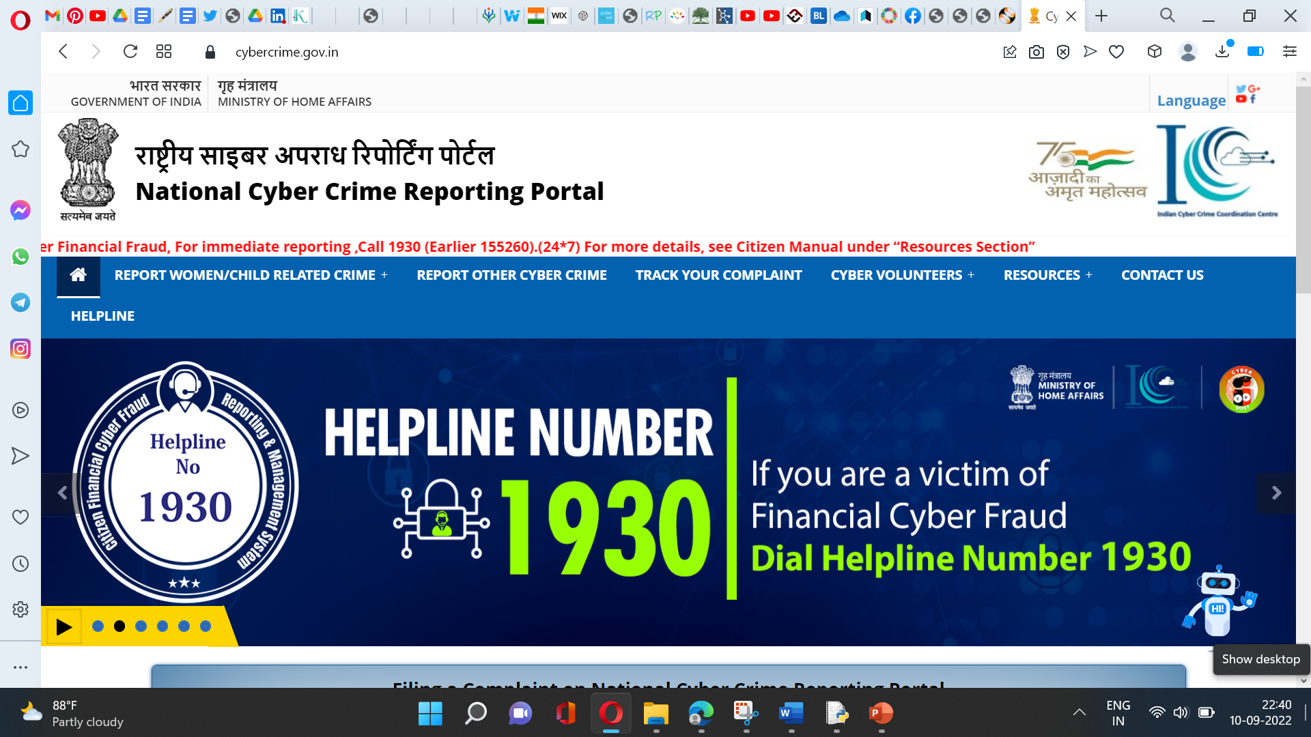
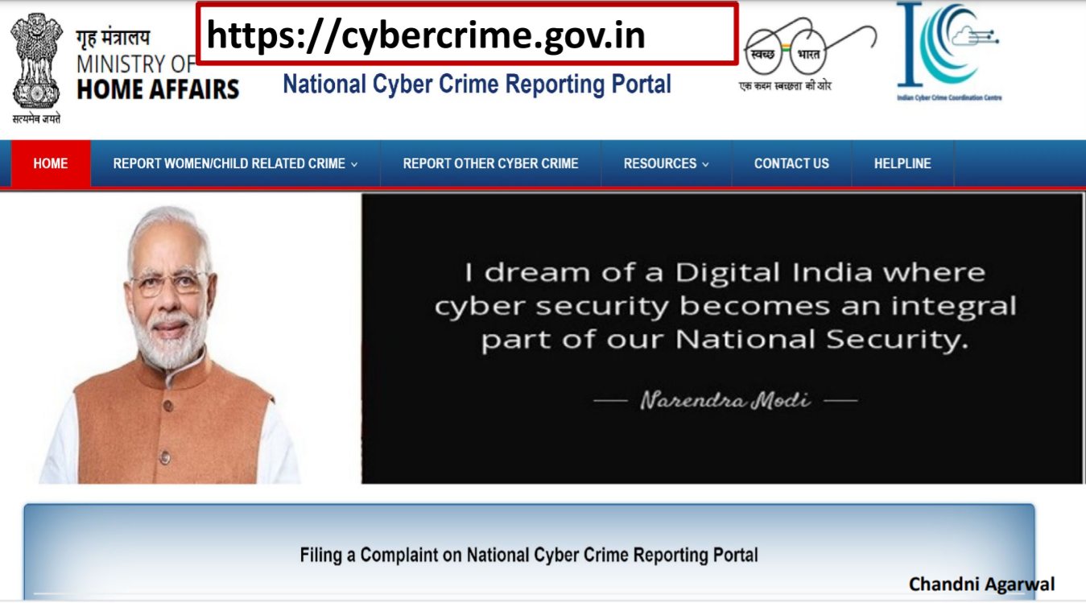
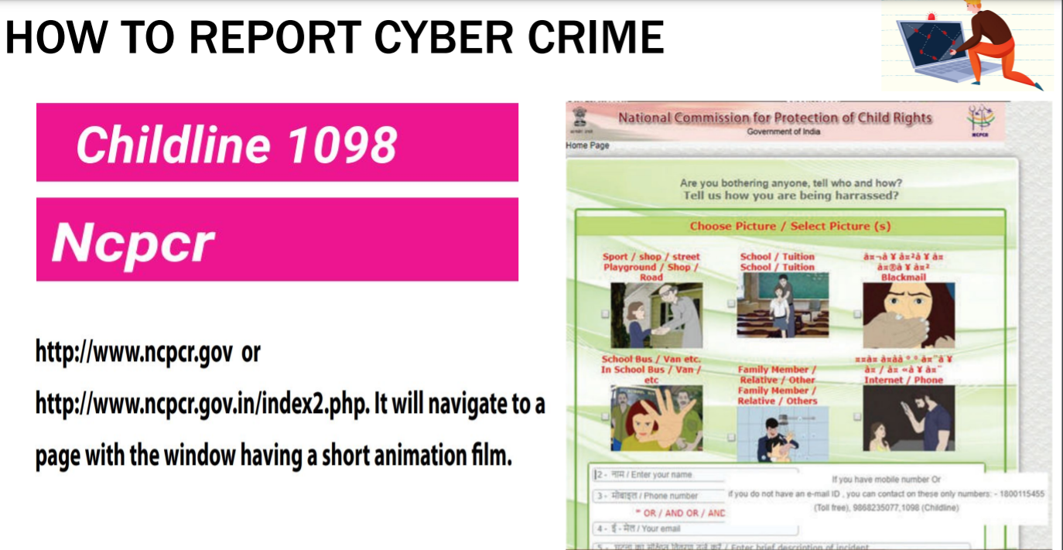
Cybercrime cases can be reported at the website www.cybercrime.gov.in or through the Helpline No 1930

Slide 13

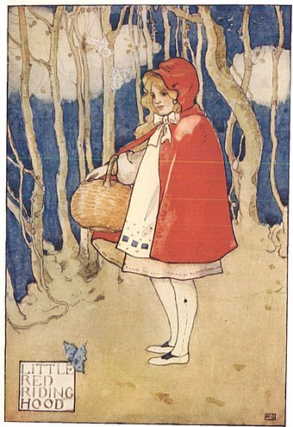

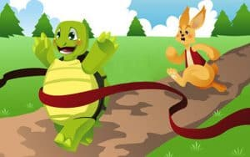
The Cyber Ethics Quest: A Fairy Tale Activity
Identify ethical and unethical online behaviour based on fairy tale scenarios.
    Little Red Riding Hood receives a message from the "Wolf" online. Should she accept the friend request?
    The Three Little Pigs post pictures of their brick and stick houses online. Is this a good idea?
    The Tortoise challenges the Hare to an online race and hacks his way to victory. Is this fair?
This Photo by Unknown Author is licensed under CC BY-SA

Slide 14
Choose a few well-known fairy tales and create a scenario that presents an ethical dilemma related to online behaviour.
Divide the class into groups and assign each group a fairy tale dilemma.
Have each group discuss the dilemma and act out two scenes:
    Scene 1: The characters make the unethical online choice.
    Scene 2: The characters make the ethical online choice.
  Facilitate a discussion about the consequences of each choice.
  Discuss what makes a choice ethical or unethical online.

Slide 15


Guardians of the Digital Realm: Design Your Cyber Hero!
Design a super man/ super woman who fights online villains.
It allows them to participate, discuss, and create rules for being safe and responsible digital citizens.
This Photo by Unknown Author is licensed under CC BY-SA-NC

Slide 16
Netiquette
Netiquette, short for "network etiquette" or "internet etiquette," is a set of informal guidelines for appropriate and respectful online behavior. It's essentially etiquette for the digital world, similar to how traditional etiquette guides our behavior in social situations.
Netiquette helps foster positive and productive online communication.
It encourages users to be mindful of others and treat everyone with respect, even if they disagree.
Following netiquette benefits everyone by creating a more pleasant and respectful online environment. It helps build trust and credibility online, strengthens relationships, and avoids unnecessary conflict. Remember, even though it's not a strict set of rules, practicing good netiquette goes a long way in making the online world a better place for everyone.

Slide 17
This includes aspects like:
Being courteous and professional in your communication, avoiding inflammatory language or personal attacks.
Respecting privacy and avoiding sharing personal information about others without their consent.
Following the rules and guidelines of specific online platforms you use, such as forums or social media.
Being mindful of the tone your writing conveys, as text-based communication can easily lead to misunderstandings.
Avoiding spreading misinformation and being critical of the information you encounter online.

Slide 18
Types of netiquettes
One to one communication
One to many communication
Specific Platforms

Slide 19
Activity: Netiquette Olympics
Netiquette Stations:
- Set up three different stations, each focusing on one type of netiquette (Email, Social Media, and Gaming).
- At each station, provide printed guidelines/rules for that specific type of netiquette.
- Assign each group to a station and give them a specific amount of time to read and understand the guidelines/rules.
- Encourage students to discuss within their groups and come up with examples or scenarios related to each type of netiquette.

Slide 20
Critical Thinking
Critical thinking is the intellectual process of actively and skillfully analyzing information, arguments, and situations to form well-reasoned judgments and informed decisions.

Slide 21
Critical Thinking
Analysis
Evaluation
Synthesis
Problem-solving
Reasoning
Open-mindedness

Slide 22
Fact-checking of Information:
Check Credentials
Read the “About Us” section.
Look for Bias
Check the Dates
Check out the Source
Examine URLs
Suspect the sensational -
Judge Hard

Slide 23

Plagiarism
Plagiarism is essentially taking someone else's work and presenting it as your own. This can involve using their words, ideas, or even just their structure without giving them proper credit.

Slide 24
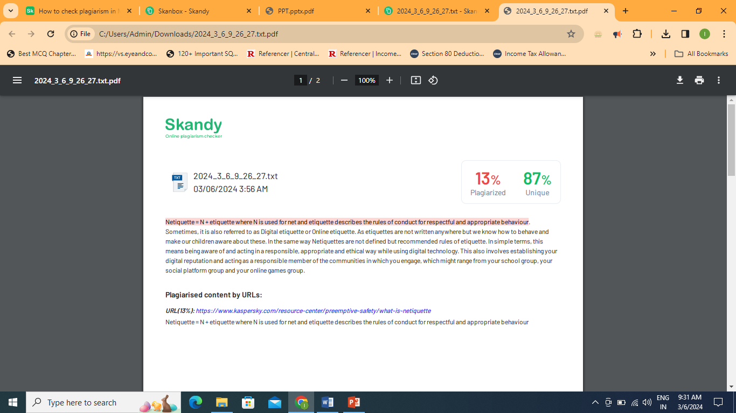

Slide 25
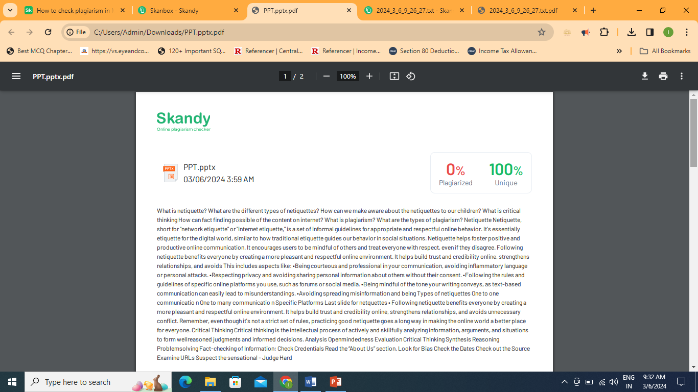

Slide 26
Word for word (Verbatim) quotation without clear acknowledgement
Copy and paste from the Internet without clear acknowledgement
Paraphrasing
Collusion
Failure to acknowledge assistance
Utilizing content authored by experts or other individuals
Self-plagiarism

Slide 27
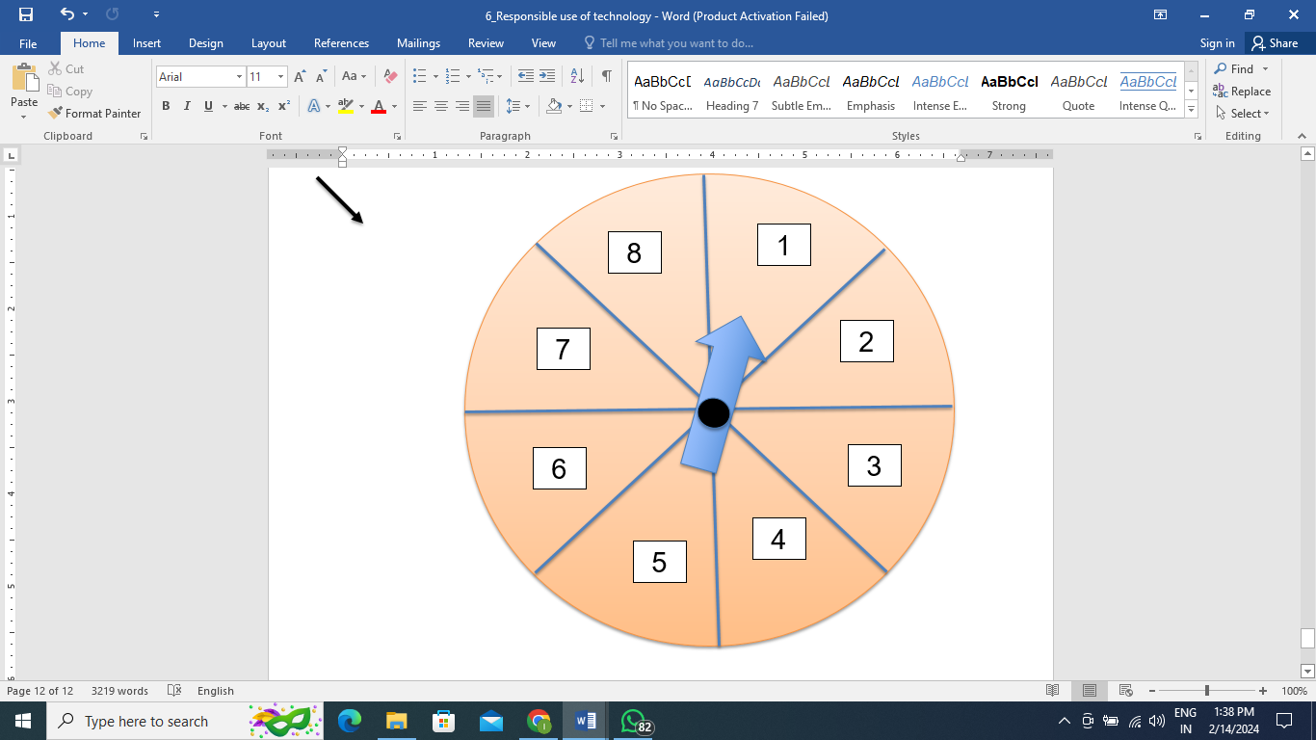
Activity: Plagiarism

Slide 28


I am Using
Internet For
Posting a photo
Checking into a location
Filling out a form
Leaving a blog comment
Updating my status
Emailing or IMing a friend
Visiting a website
Online Shopping/Transactions
This Photo by Unknown Author is licensed under CC BY-SA-NC

Slide 29
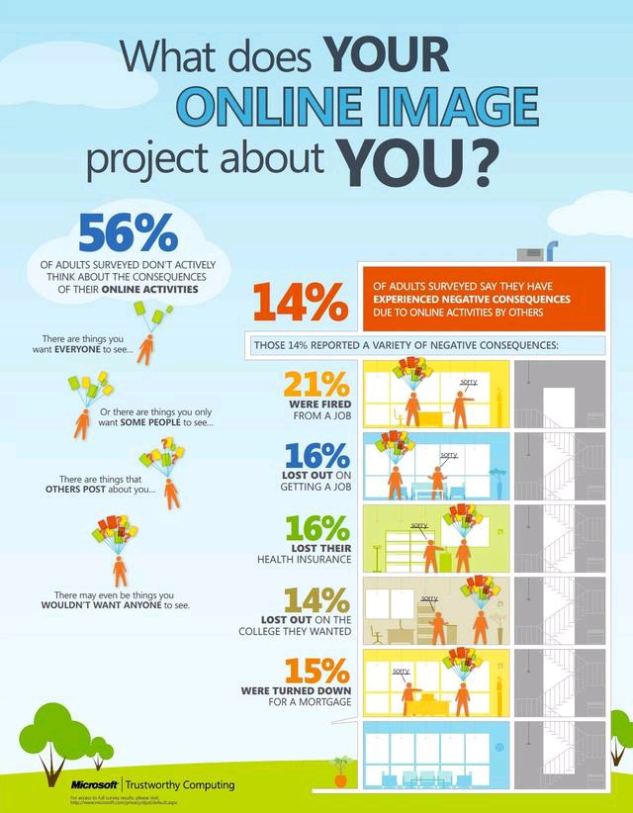

No matter where we go, we leave behind a footprint that others can see.

Slide 30
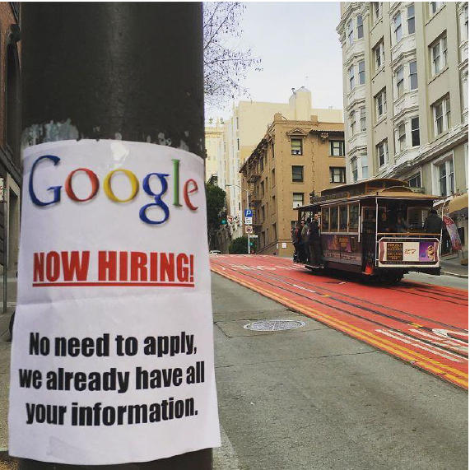
This Photo by Unknown Author is licensed under CC BY-SA-NC
This Photo by Unknown Author is licensed under CC BY-SA-NC

Slide 31

The trail of information we leave behind whenever we use the internet is our
DIGITAL FOOTPRINT.
It’s not just our own online actions we need to worry about—what others say and post about us also contributes to our digital footprint.

Slide 32
Here are other reasons why DIGITAL FOOTPRINTS matter so much:
They’re pretty much permanent. Once we create a digital footprint, it’s there forever.
If the information associated with our digital footprint becomes public, we’ll have little control over how it’s used by others, such as advertisers.
Our digital footprint is our online reputation. That online reputation can affect our offline reputation too.
Every day, whether we want to or not, most of us contribute to a growing portrait of who we are online
A portrait that is probably more public than we assume.

Slide 33
Privacy Treasure Hunt
Identify which pieces of information should be kept private and why?
"I am your friend, and I want to know your home address so I can send you a birthday card."
Sarah is excited to share her recent family vacation photos on social media. She uploads several pictures, including ones that clearly show the address of their home."
Maya shares her login credentials with her friend so they can complete the science project together. Is it safe for Maya to share her password with someone else?
Priya wants to participate in an online quiz that requires her to provide her full name, date of birth, and address. Should Priya share this information with the website?
You attended the birthday party of your friend, you had a lot of fun with your friends and captured these moments. Later you posted all the photos on your social media account.
Alex receives an email from an unknown sender claiming to be his bank, asking him to provide his account details for a security update. What should Alex do in this situation?

Slide 34
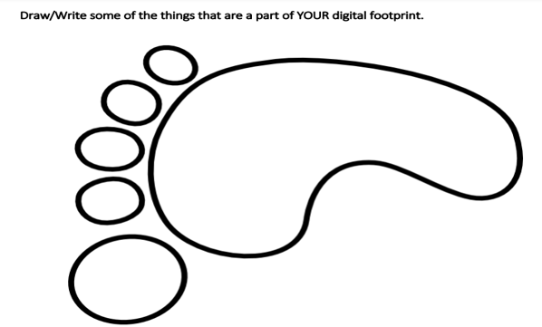
Digital Footprint Exploration
Reflect on your own Digital Footprint
How many hours do you spend online?
Which social media platforms do you use regularly?
Have you ever Googled yourself to see what information comes up?
How do you manage your privacy settings on social media and other online accounts?
What types of content do you typically post or share online?
This Photo by Unknown Author is licensed under CC BY-SA-NC

Slide 35
Divide the students into small groups and assign each group a specific online platform or activity to analyze (e.g., Facebook, Instagram, online gaming, web browsing history).
Instruct the groups to conduct a brief investigation into the platform or activity assigned to them. They should explore the types of data that are collected, the privacy settings available, and any potential risks associated with using the platform.
Have each group present their findings to the class. They should share insights about the platform or activity they analyzed, discuss the implications for digital footprints, and offer recommendations for managing online privacy.
Conclude the activity by summarizing the key takeaways about digital footprints and the importance of responsible online behavior. Encourage students to share any final thoughts or questions they have.

Slide 36
We need to find a balance between the digital world and the real world. Technology should enhance our lives, not replace them."
–
Sheryl Sandberg, COO of Meta Platforms

